Slide 1
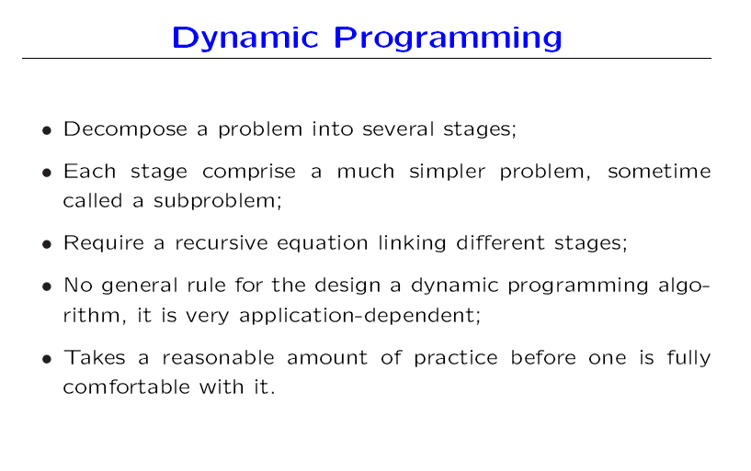

Slide 2
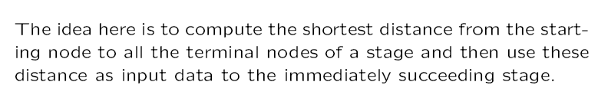
Ex: Shortest Route Problem:
A salesman located in a city A decided to travel city A to city B. He knew the distances of alternative routes from city A to city B. He then drew a highway network map as shown. The city of origin ,A, is city 1. The destination cit B, is city 7.Other cities through which the salesman will have to pass through are numbered 2 to 6. The arrow representing routes between cities and distances in kilometers are indicated on each route. The salesman problem is to find the shortest route that covers all the selected cities from A to B.

Slide 3
12
2
5
9
7
8
1
8
7
3
9
6
5
7
Stage 3
Stage 0
6
4
13
Stage 2
Stage 1

Slide 4
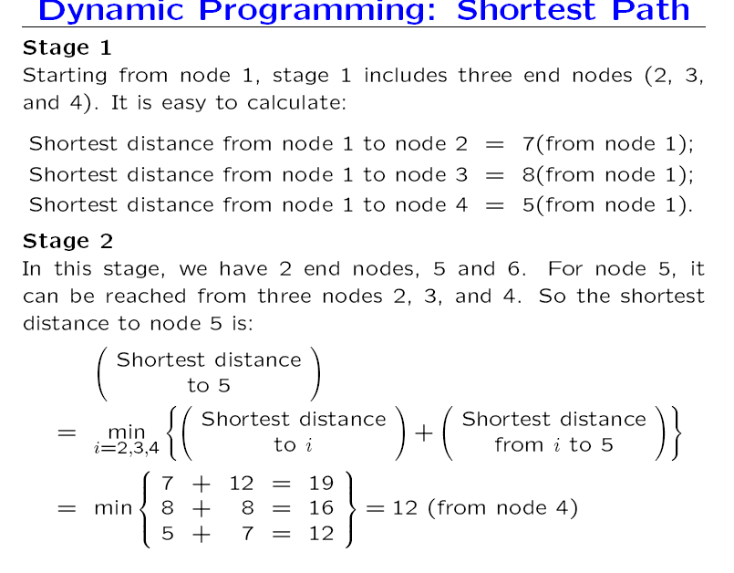

Slide 5
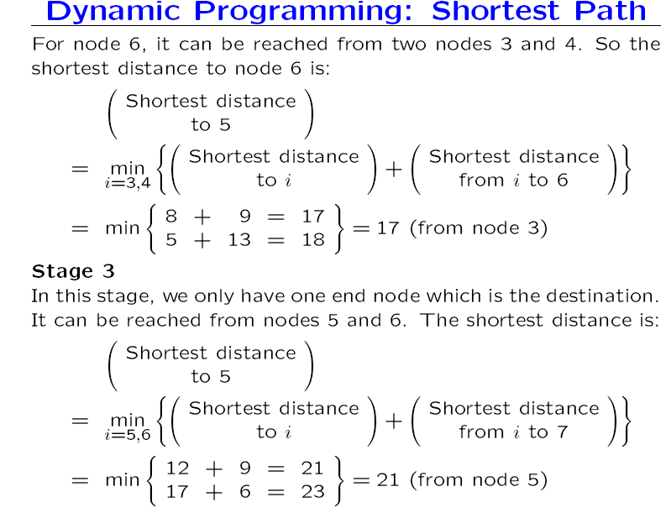
6
7

Slide 6
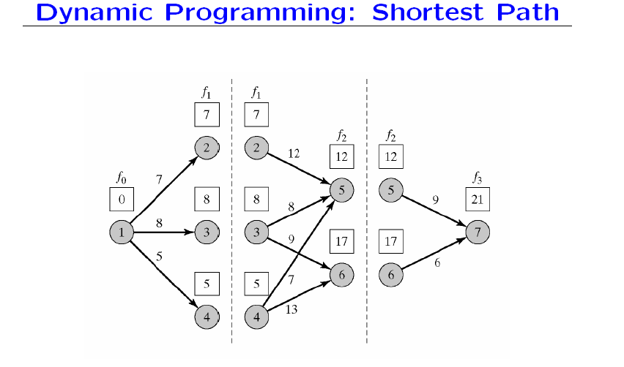

Slide 7
The optimal result is :
Sequence: 1 4 5 7
Distances: 5 7 9
The optimal path having a minimum distance of 21 kilometres.

Slide 8
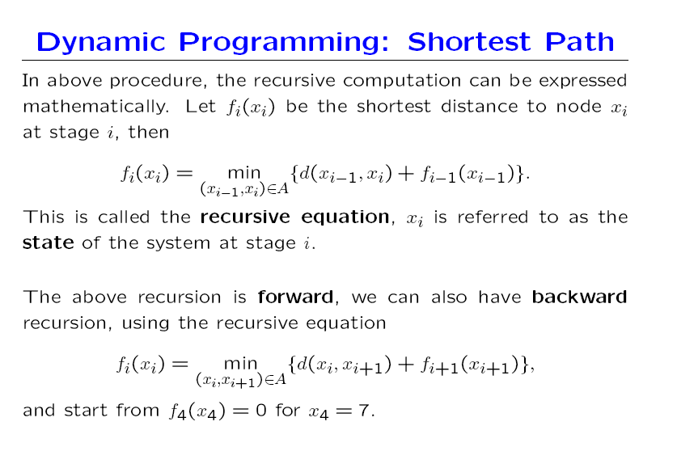

Slide 9
By Backward Recursive method:
Stage 4: f₄(x₄) = 0
Stage 3:
Stage 2:
 | d(x₃,x₄) | Optimum solution
x₃ | x₄ = 7 | f₃(x₃) | x₄*
5 | 9 | 9 | 7
6 | 6 | 6 | 7
 | d(x₂,x₃)+ f₃(x₃) |  | Optimum solution
x₂ | x₃ = 5 | x₃ = 6 | f₂(x₂) | x₃*
2 | 12+9 = 21 | ------ | 21 | 5
3 | 8+9 = 17 | 9+6 =15 | 15 | 6
4 | 7+9 =16 | 13+6 = 19 | 16 | 5

Slide 10
Stage 1:
 | d(x₁,x₂) + f₂(x₂) |  |  | Optimum solution
x₁ | x₂= 2 | x₂= 3 | x₂= 4 | f₁(x₁) | x₂*
1 | 7+21 = 28 | 8+15 =23 | 5+16 = 21 | 21 | 4
The optimal result is :
Sequence: 1 4 5 7
Distances: 5 7 9
The optimal path having a minimum distance of 21 kilometres.

Slide 11
Basic elements of DP model
Stages
Alternatives at each stage
States for each stage

Slide 12
Dynamic Programming differs from LP in two aspects:
1.In DP, there is no set procedure (Algorithm). It allows us to break up the given problem into a sequence of easier and small sub problems.
2.LP gives one stage solution, whereas considers decision making at several stages.

Slide 13
Optimum F = f₁(y₁)+f₂(y₂)+…….+f_{n}(y_{n})
subject to
a₁y₁+a₂y₂+…….+a_{n}y_{n} ≤ = ≥ b
a_{i} , b > 0 and constant, yi ≥0
Stages: i= 1,2 …n
Alternatives: y_{i}
State Variables x_{i}: Forward recursive method
x_{n} = a₁y₁+a₂y₂+…….+a_{n}y_{n} ≤ = ≥ b
x_{n-1} = a₁y₁+a₂y₂+…….+a_{n-1}y_{n-1} = x_{n} - a_{n}y_{n}
………
x₂ = a₁y₁+a₂y₂ = x₃ – a₃y₃
x₁ = a₁y₁ = x₂ – a₂y₂

Slide 14
Cargo Loading Model
n items are to be loaded in a vessel. The weight w_{i}, and value r_{i} for item i are tabulated below.
The maximum allowable cargo weight is W tons. Formulate the ILP model to maximise the total return.
Item i | w_{i} | r_{i}
1 | w₁ | r₁
2 | w₂ | r₂
…. | ….. | ….
n | w_{n} | r_{n}

Slide 15
Let m_{i} be the no. of units of item i in the vessel
Maximise z = r₁m₁+r₂m₂+…….+r_{n}m_{n}
subject to
w₁m₁+w₂m₂+…….+w_{n}m_{n} ≤ W
m₁, m₂, ……m_{n} ≥ 0 and integer

Slide 16
Three elements of the model
Stage i : item i, i = 1, 2, ….n
Alternative at stage i : m_{i}: the no. of units of item i, m_{i} = 0,1….,[W/w_{i}].
3. State at stage i : x_{i}: total weight assigned to stages i, i+1, …..,n
The weight constraint is the only restriction that links all n stages together.

Slide 17
f_{i}(x_{i}) = maximum return for stages i, i+1, …..n
Backward Recursive Equation is as follows:
f_{n+1}(x_{n+1}) = 0
x_{i} – x_{i+1} = w_{i}m_{i}
x_{i+1} = x_{i} – w_{i}m_{i}

Slide 18
Problem
A 6-ton vessel can be loaded with one or more of three items. The following table given the unit weight w_{i}, in tons and the unit revenue in thousands of Rs. r_{i}, for item i. How should the vessel be loaded to maximise the total return?
Item i | w_{i} | r_{i}
1 | 4 | 70
2 | 1 | 20
3 | 2 | 40

Slide 19
Let m_{i} be the no. of units of item i in the vessel, then
Maximise z = 70m₁+20m₂+40m₃
subject to 4m₁+1m₂+2m₃ ≤ 6
m₁, m₂, ……m_{n} ≥ 0 and integer
Stages: i= 1,2,3
Alternatives: m_{i;} m_{i} = 0,1….,[W/w_{i}].
State Variables x_{i}: x₁ = 4m₁+1m₂+2m₃ ≤ 6
x₂ = 1m₂+2m₃ = x₁ – 4m₁
x₃ = 2m₃ = x₂ – 1m₂

Slide 20
f₃(x₃) = max {40m₃}
f₂(x₂) = max {20m₂ + f₃(x₃)}
f₁(x₁) = max {70m₁ + f₂(x₂)}
Stage 3:
max {m₃ }= [W/w₃] = [6/2] = 3
i.e. m₃ = 0, 1,2, 3
An alternative m₃ is feasible only if x₃ ≥ w₃m₃
i.e. x₃ ≥ 2m₃ .

Slide 21
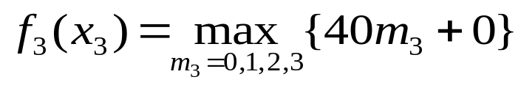
Stage 3:
 | 40m₃ |  |  |  | Optimum sol
x₃ | m₃ = 0 | m₃ = 1 | m₃ =2 | m₃ = 3 | f₃(x₃) | m₃
0 | 0 | - | - | - | 0 | 0
1 | 0 | - | - | - | 0 | 0
2 | 0 | 40 | - | - | 40 | 1
3 | 0 | 40 | - | - | 40 | 1
4 | 0 | 40 | 80 | - | 80 | 2
5 | 0 | 40 | 80 | - | 80 | 2
6 | 0 | 40 | 80 | 120 | 120 | 3
Stage 2:
max {m₂ }= [W/w₂] = [6/1] = 6
i.e. m₂ = 0, 1,2, 3,4,5,6
An alternative m₂ is feasible only if w₂m₂ ≤ x₂.
i.e. x₂ ≥ 1m₂ .

Slide 22
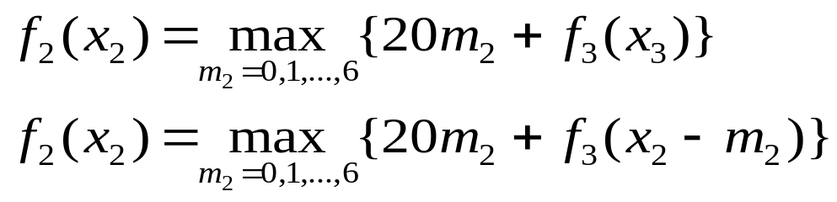
Stage 2:
 | 20m₂ + f₃(x₂-m₂) |  |  |  |  |  |  | Optimum sol
x₂ | m₂ = 0 | m₂ = 1 | m₂ =2 | m₂ = 3 | m₂ = 4 | m₂ = 5 | m₂ = 6 | f₂(x₂) | m₂
0 | 0 | - | - | - | - | - | - | 0 | 0
1 | 0 | 20 | - | - | - | - | - | 20 | 1
2 | 40 | 20 | 40 | - | - | - | - | 40 | 0,2
3 | 40 | 60 | 40 | 60 | - | - | - | 60 | 1,3
4 | 80 | 60 | 80 | 60 | 80 | - | - | 80 | 0,2,4
5 | 80 | 100 | 80 | 100 | 80 | 100 | - | 100 | 1,3,5
6 | 120 | 100 | 120 | 100 | 120 | 100 | 120 | 120 | 0,2,4,6
Stage 1:
max {m₁ }= [W/w₁] = [6/4] = 1
i.e. m₁ = 0, 1
An alternative m₁ is feasible only if w₁m₁ ≤ x₁., i.e. x₁ ≥ 4m₁ .

Slide 23
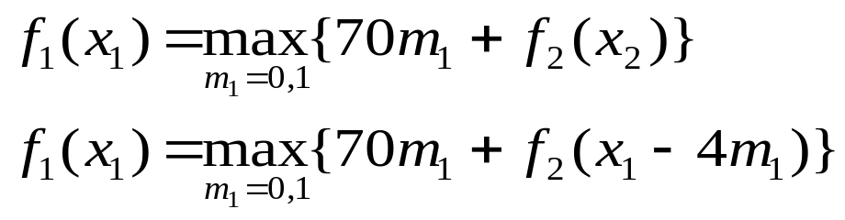
Stage 1:
 | 70m₁+f₂(x₁-4m₁) |  | Optimum sol
x₁ | m₁ = 0 | m₁ = 1 | f₁(x₁) | m₁
0 | 0 | - | 0 | 0
1 | 20 | - | 20 | 0
2 | 40 | - | 40 | 0
3 | 60 | - | 60 | 0
4 | 80 | 70 | 80 | 0
5 | 100 | 90 | 100 | 0
6 | 120 | 110 | 120 | 0

Slide 24
Given W= 6 tons.
From stage 1: x₁ = 6 , m₁ = 0
From stage 2: x₂ = x₁ - 4m₁ = 6, m₂ = 0,2,4,6
From stage 3: x₃ = x₂ – m₂ = 6,4,2,0
m₃ = 3,2,1,0.
f₁(6) = 120.
The optimal solution is
(m₁,m₂,m₃) = (0,0,3), (0,2,2), (0,4,1), (0,6,0)
with max z = 120.

Slide 25
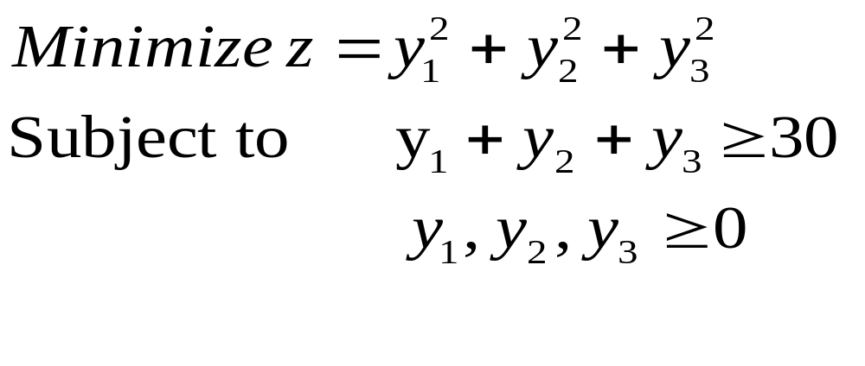
Problem: Find 3 nonnegative real no. such that the sum of squares of these no. is min. with the restriction that their sum is not less than 30.

Slide 26
Forward recursive equation:
Stages: i= 1,2,3
Alternatives: y_{i;} i = 1,2,3
State Variables x_{i}: x₃ = y₁+y₂+y₃ ≥30
x₂ = y₁+y₂ = x₃ – y₃
x₁ = y₁ = x₂ – y₂
f₁(x₁) = min {y₁²}
f₂(x₂) = min {y₂² + f₁(x₁)}
f₃(x₃) = min {y₃² + f₂(x₂)}
The optimal solution is:
y₁ = y₂ = y₃ = 10 with min z = 300

Slide 27
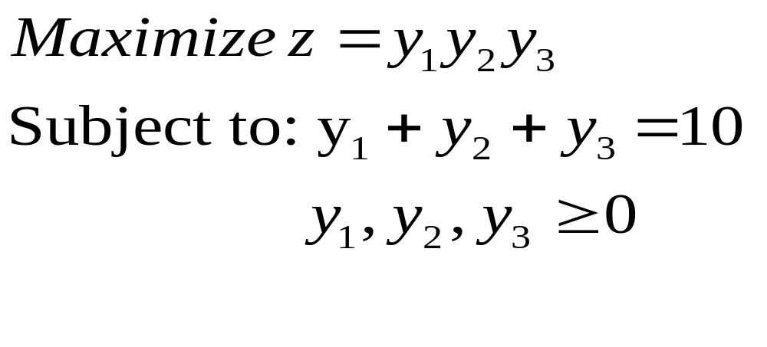
Solution of LP by Dynamic Programming
Algorithm:

Slide 28
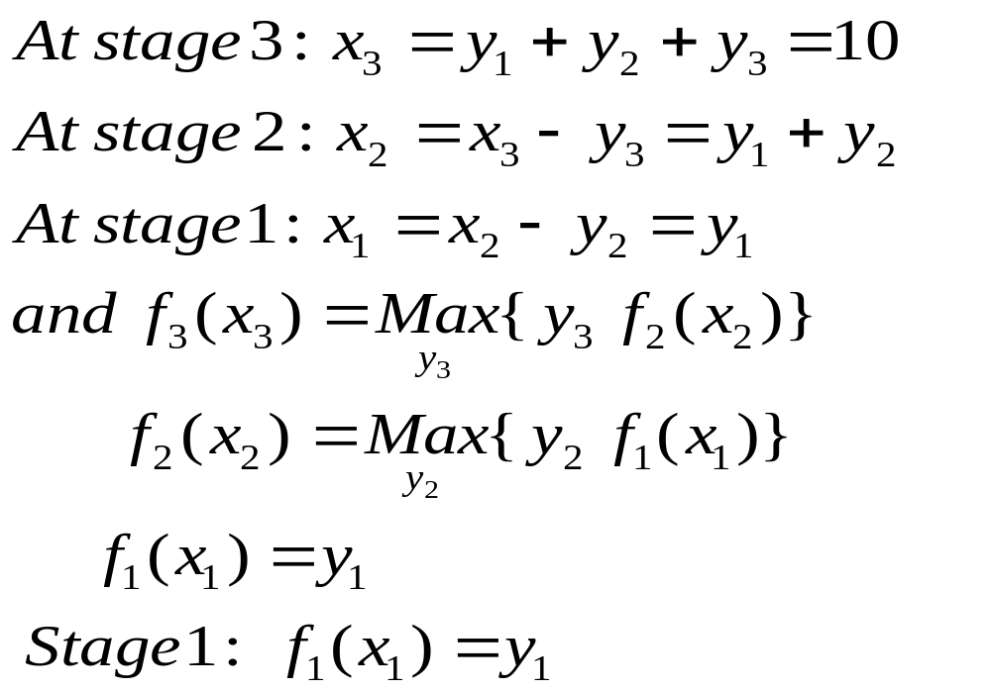

Slide 29
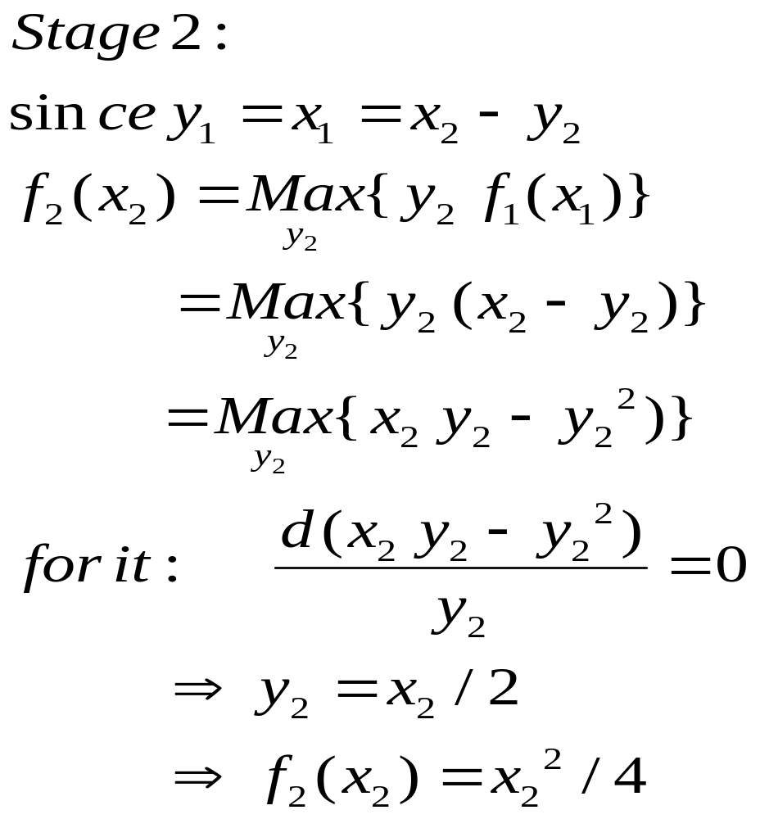

Slide 30
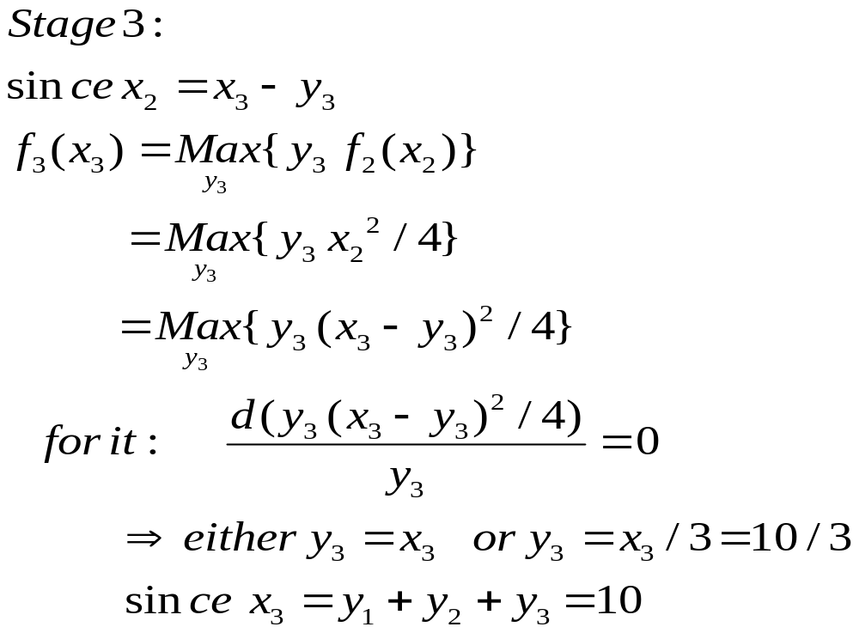

Slide 31
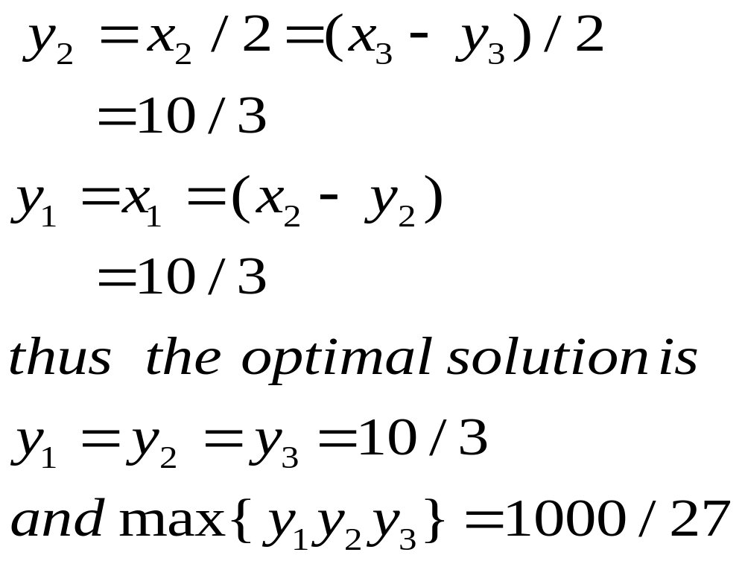

Slide 32
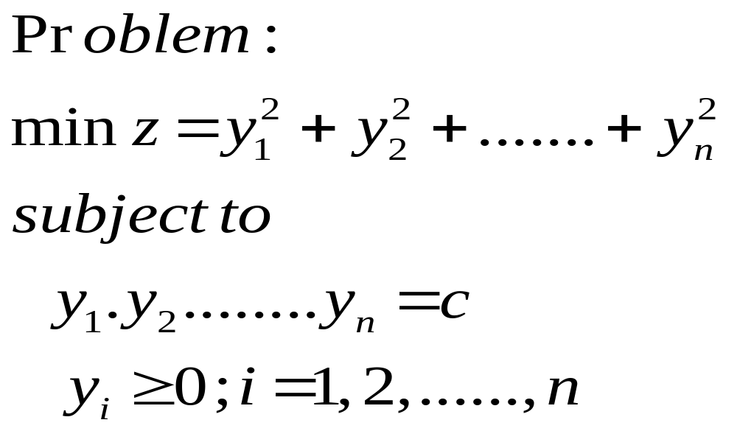
Solution of LP by Dynamic Programming Algorithm:

Slide 33
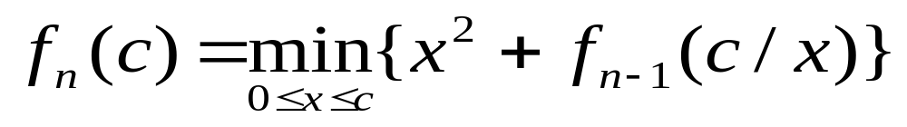
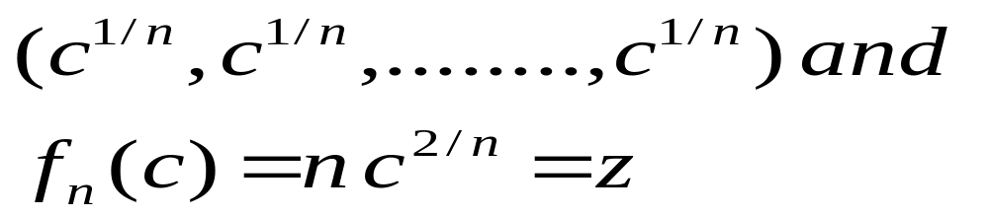
The recursive equation for general value of x:
The optimal policy:

Slide 34
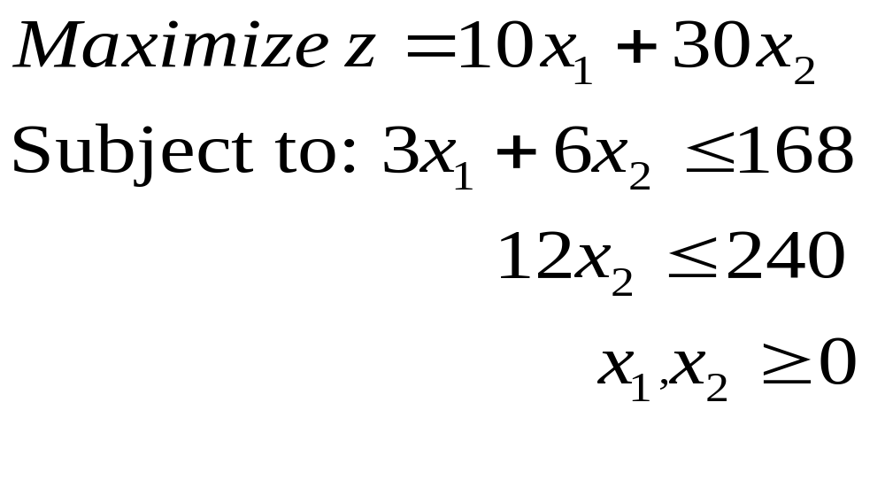
Solution of LP by Dynamic Programming
Algorithm:

Slide 35
Solution:
Stages: i = 1,2
Alternatives: x_{i} for stage i.
States: (b₁₁,b₂₁) and (b₁₂,b₂₂).
Backward recursion:
b₁₁ = 3x₁ + 6x₂ ≤ 168
b₂₁ = 0x₁+ 12x₂ ≤ 240
b₁₂ = 6x₂ = b₁₁ - 3x₁,
b₂₂ = 12x₂ = b₂₁ – 0x₁.

Slide 36
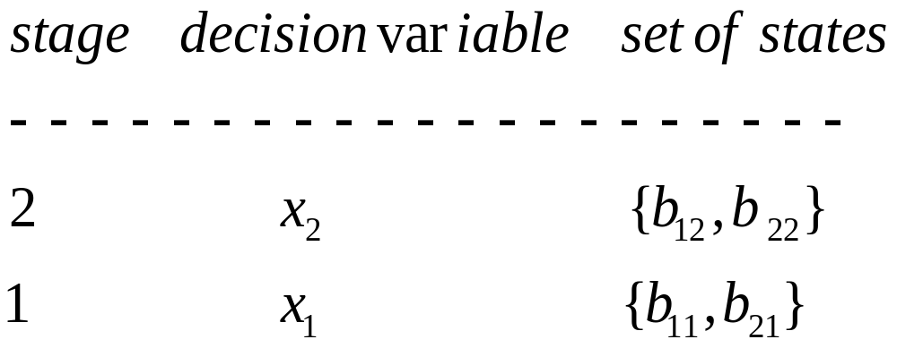
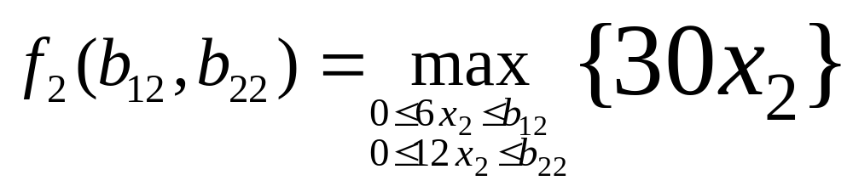
Stage 2:

Slide 37
Thus, max{30x₂}occurs at
x₂ = min {(b12/6),(b22/12)}
The solution for stage 2 is:
 | Optimum solution
State | f₂(b₁₂,b₂₂) | x₂.
(b₁₂,b₂₂) | 30 min {(b₁₂/6),(b₂₂/12)} | min {(b₁₂/6),(b₂₂/12)}

Slide 38
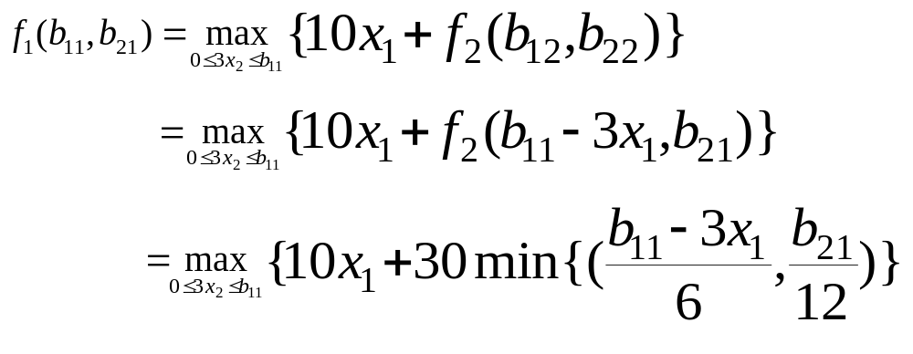
Stage 1:

Slide 39
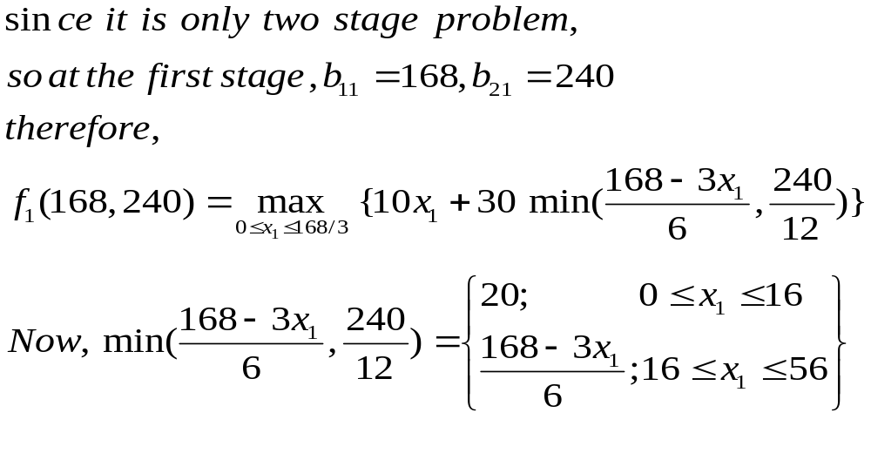

Slide 40
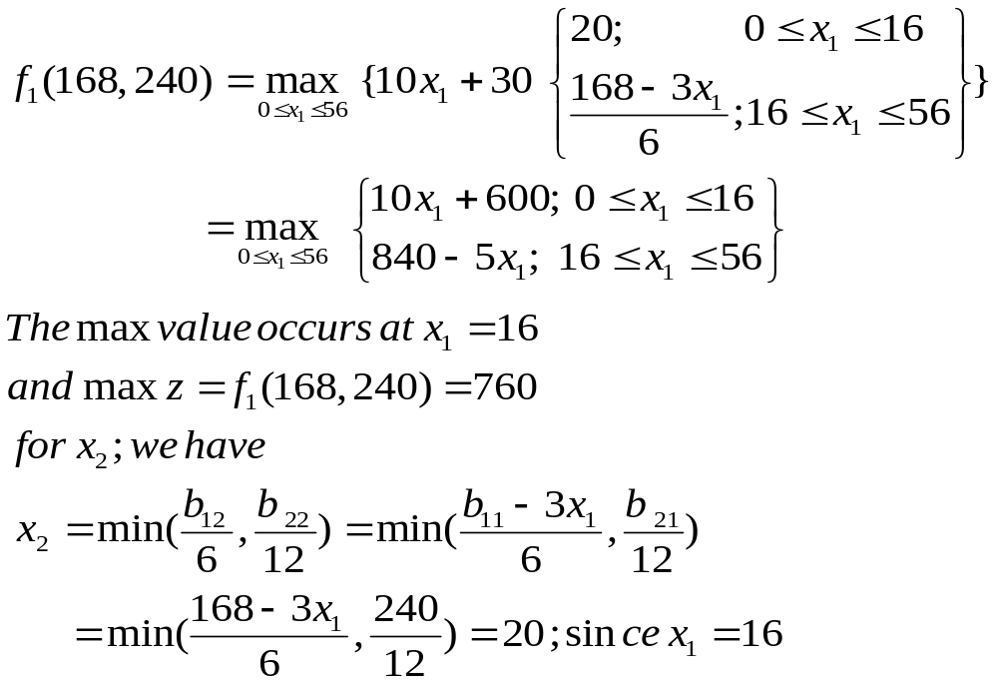

Slide 41
